Slide 1
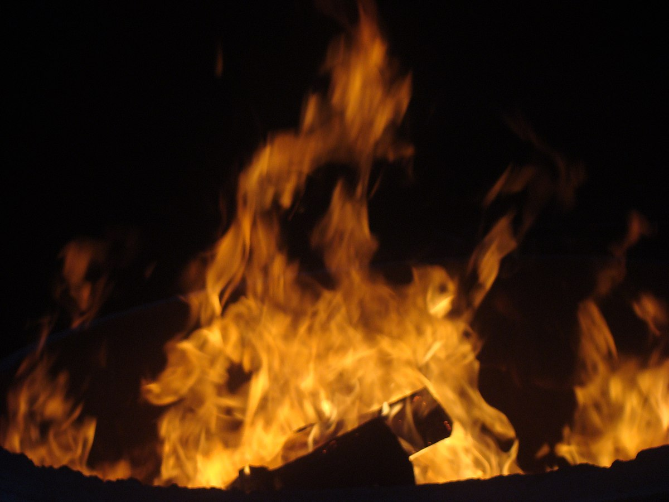
Fire Safety part 2

Slide 2
Plan
Combustion
Definition
Different Fuels
Typology
Extinguishing
Principle
Fire Classes
Extinguishing Agents
Extinguishing Foam

Slide 3

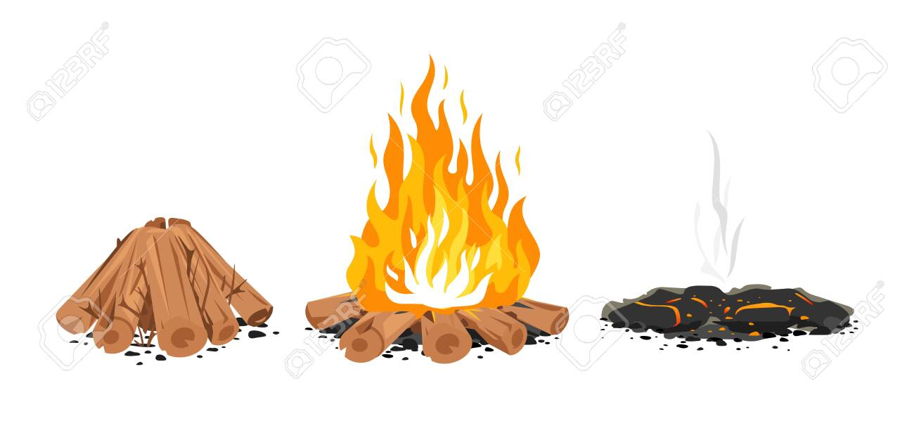
Fire compositions
Flame. It refers to the visible, hot, and often brightly burning gas or vapor that is produced during combustion, such as in a fire or when a candle is lit.
Embers of the fire. It refers to the glowing, smoldering remains of a fire, typically in the form of hot, glowing pieces of wood or charcoal.
Smoke: It refers to the cloud of tiny, airborne particles and gases that is typically produced when a substance is burned. Smoke is often associated with fires, chimneys, or other combustion processes.
Ashes of the fire. It refers to the powdery residue left behind after a fire has burned, typically consisting of the remains of burnt materials such as wood, paper, or other combustible substances.

Slide 4
Different Types of Combustion
Very Slow Combustion
This involves oxidation without any emission of light or an increase in temperature. Example: corrosion
Slow Combustion
This involves oxidation with an emission of light where the temperature remains below 500°C. Example: fermentation
Rapid Combustion
This involves fire. Emission of flames and release of heat, with a propagation speed of a few meters per second.
Very Rapid Combustion (Deflagration)
This is an explosion with a propagation speed slower than the speed of sound and a pressure of 30 tons per m².
Instantaneous Combustion (Detonation)
This is an explosion with a propagation speed faster than the speed of sound and a pressure of 300 tons per m².

Slide 5
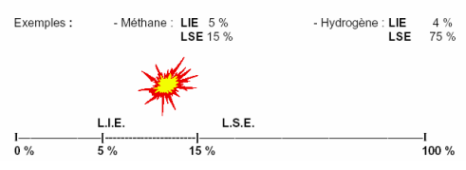
COMBUSTION
Different Types of Fuels
Gaseous Fuels
Inflammation occurs only if its concentration in the air is between:
  The Lower Flammability Limit (LFL) or Lower Explosive Limit (LEL)
  The Upper Flammability Limit (UFL) or Upper Explosive Limit (UEL)

Slide 6
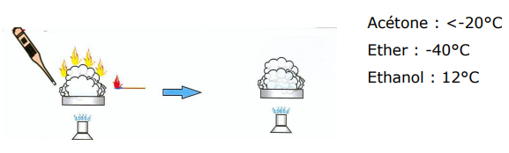
COMBUSTION
Different Types of Fuels
Liquid Fuels
Flash Point (PE) : This is the minimum temperature at which a product must be heated so that its emitted vapors ignite in the presence of a flame. The phenomenon stops when the flame is removed.

Slide 7
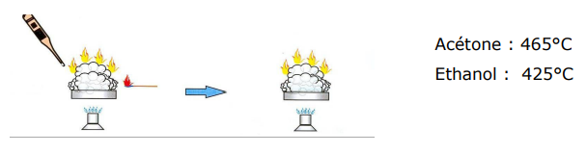
COMBUSTION
Different Types of Fuels
Liquid Fuels
Ignition Point (PI) or Fire Point After reaching the flash point, if we continue to heat the substance, it continues to burn even when the flame is removed.

Slide 8
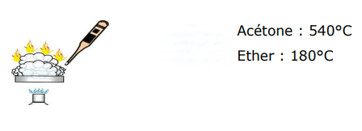
COMBUSTION
Different Types of Fuels
Liquid Fuels
Auto-Ignition Point (PAI) This is the minimum temperature at which the vapors ignite on their own without a flame.

Slide 9
COMBUSTION
Different Types of Fuels
Solid Fuels
State of Division: The more the material is divided, the faster and more complete the combustion (e.g., a pile of paper vs. a sheet of paper).
Importance of the Heat Source

Slide 10
COMBUSTION
Typology
Slow Combustion: Oxidation (phenomenon of rust formation)
Rapid Combustion: Fire
Very Rapid Combustion: Deflagration
Instantaneous Combustion: Explosion

Slide 11
Stopping Combustion
To stop combustion, it is enough to remove one of the elements of the fire triangle.
Oxidizer
This is about preventing oxygen from fuelling the fire:
- Blanket, soil, sand
- Lid
- Inert gas
- Water in a diffused jet
Foam
Action: Smother the fire

Slide 12
Stopping Combustion
Fuel
This is about preventing the fire from having something to burn:
Remove what is burning
Close the source
Action: Clear away, Cut off the supply

Slide 13
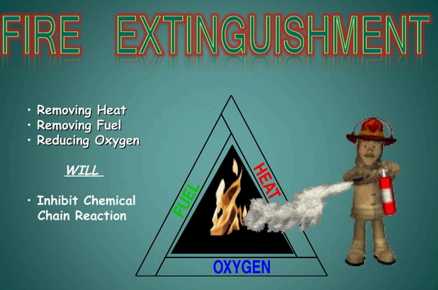

Slide 14
Stopping Combustion
Activation Energy (Heat)
This is about reducing the energy of the fire:
- Water
- Other extinguishing agents such as CO₂
Foam
Action: Cool down

Slide 15
Extinguishing Agents
Most Common
- Water
- Water with additive (wetting agent)
- Physical or chemical foam, AFFF (Aqueous Film Forming Foam)
- Foam for polar products (alcohol)
- BC Powder
- ABC Powder (multipurpose)
- D Powder (for special fires)
- Carbon dioxide (for electrically originated fires)
Other Extinguishing Agents
- Dry sand
- Soil
- Dry cement
- Blanket

Slide 16
The common classification of fires and their corresponding extinguishing agents includes:
Class A Fires (Ordinary Combustibles):
  Extinguishing Agent: Water, water-based foam, or multipurpose dry chemical extinguishers.
Class B Fires (Flammable Liquids and Gases):
  Extinguishing Agents: Foam, carbon dioxide (CO2), dry chemical powders, or specialized flammable liquid fire extinguishers.
Class C Fires (Electrical Fires):
  Extinguishing Agents: Carbon dioxide (CO2), dry chemical powders, or clean agents (like Halon or clean agent alternatives) that do not conduct electricity.
Class D Fires (Combustible Metals):
  Extinguishing Agents: Specialized dry powders designed for the specific type of metal involved in the fire. Examples include sodium chloride for sodium fires or copper-based agents for lithium fires.
Class K Fires (Cooking Oils and Fats):
  Extinguishing Agent: Wet chemical extinguishers designed for kitchen and restaurant use. They create a soap-like foam to suppress and cool down these high-temperature fires.

Slide 17
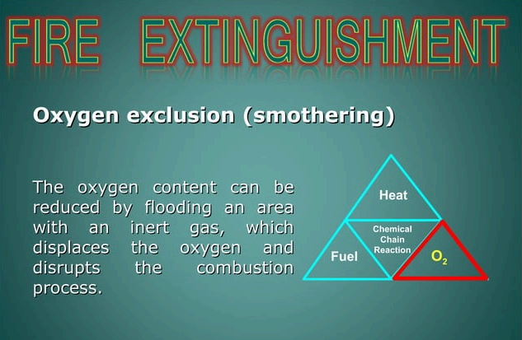

Slide 18
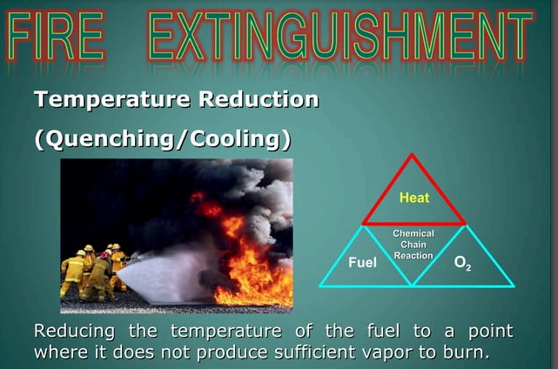

Slide 19
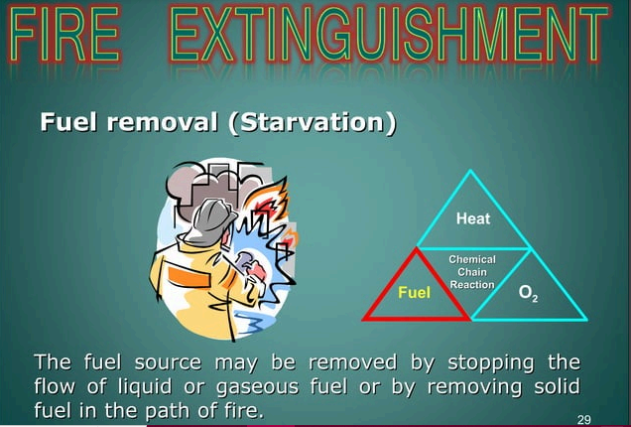

Slide 20
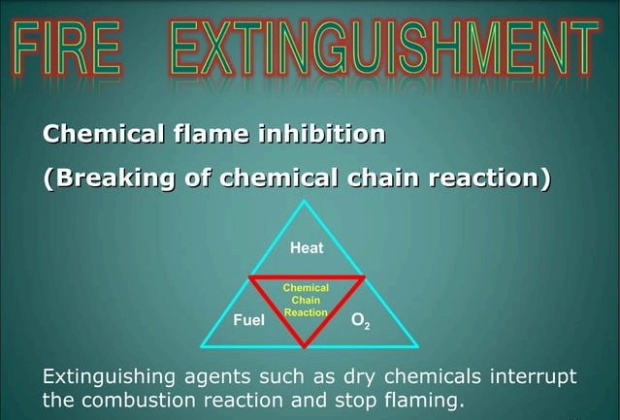

Slide 21
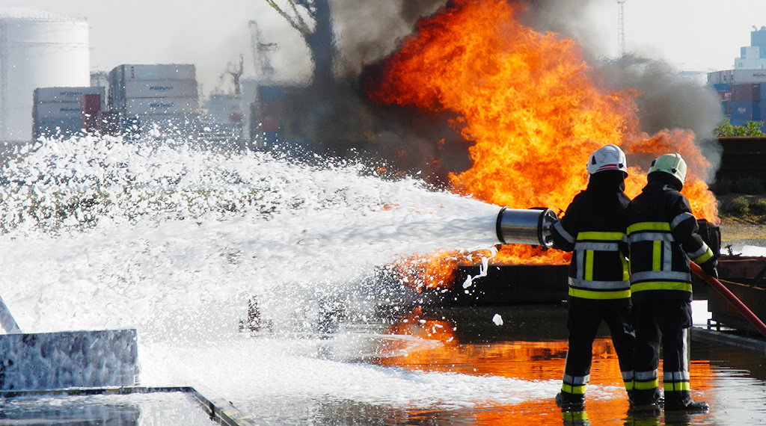
Extinguishing foams

Slide 22
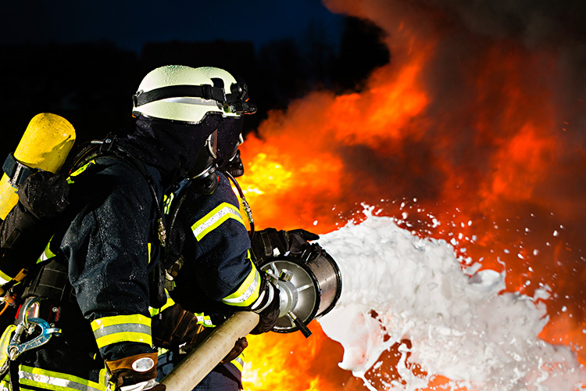
Extinguishing foams
Definition: An extinguishing foam is an aggregate of bubbles, more or less fine, consisting of gas trapped in a thin film of water mixed with an emulsifying agent.
It used to control and extinguish flammable liquid fires, and they work by creating a blanket of foam that suppresses the fire and prevents the release of flammable vapors.

Slide 23
Foam action
• Isolation of flammable vapors and gases.
• Cooling by the water contained in the foam.
• Smothering by preventing the supply of O2.
• Shield against radiant heat from a fire or the sun.

Slide 24
Foam production
To produce foam, it is necessary to mix, through vigorous stirring, the following three components:
Pressurized water
Emulsifier
Gas (CO2 for chemical foams and ambient air for physical foams)"

Slide 25
Emulsifier
Definition:
It is a fluid that has the property of reducing the surface tension of the water with which it is mixed, allowing the formation of gaseous bubbles.
Like soap... There are several types: Protein-based (P), fluoroprotein-based (FP), film-forming foaming agents (AFFF), synthetic (S), and multi-purpose (PL).

Slide 26
Characteristics of Foams
Depending on the desired effect, foam can be used in different forms. Two concepts are used to characterize the foam:
EXPANSION RATE : ER
CONCENTRATION RATE : CR

Slide 27
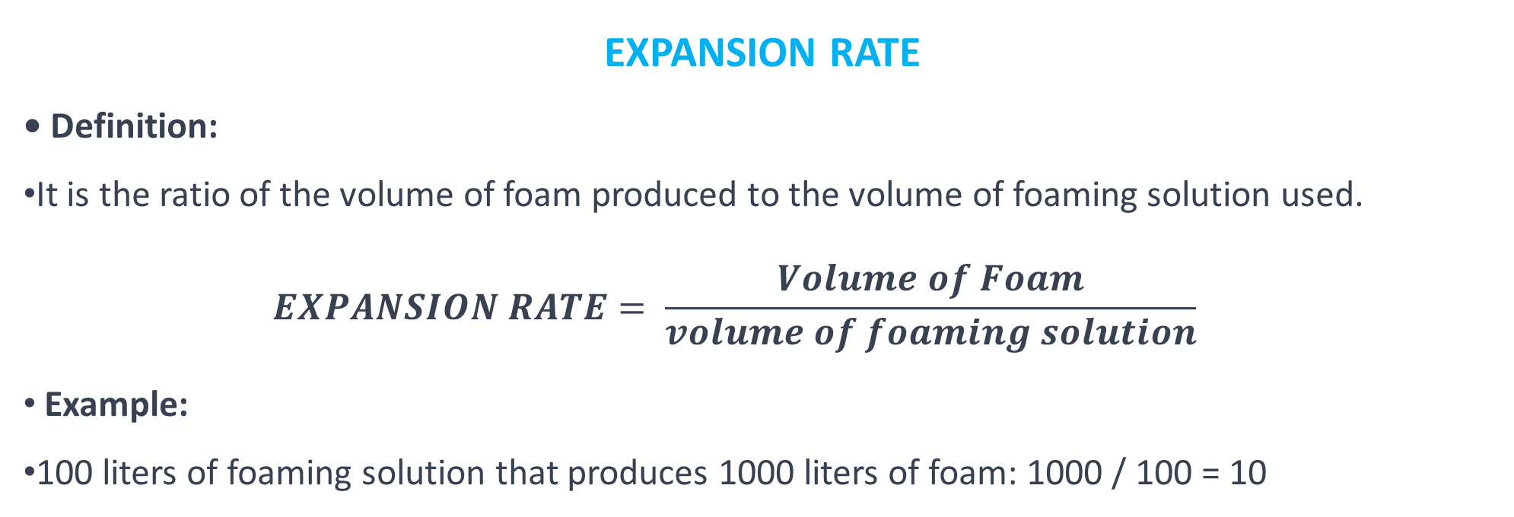
EXPANSION RATE
• Definition:
It is the ratio of the volume of foam produced to the volume of foaming solution used.
  $$EXPANSION RATE= \frac{Volume of Foam}{volume of foaming solution}$$
Example:
100 liters of foaming solution that produces 1000 liters of foam: 1000 / 100 = 10
Classification
From 0 to 20: Low expansion
From 20 to 200: Medium expansion
200 and above: High expansion

Slide 28
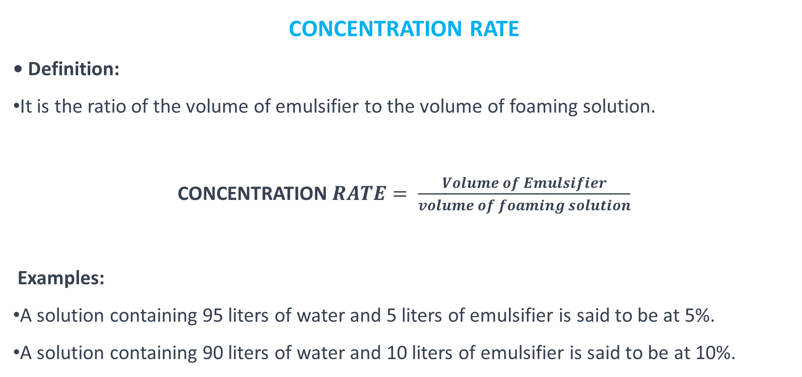
CONCENTRATION RATE
• Definition:
It is the ratio of the volume of emulsifier to the volume of foaming solution.
CONCENTRATION$RATE= \frac{Volume of Emulsifier}{volume of foaming solution}$
Examples:
A solution containing 95 liters of water and 5 liters of emulsifier is said to be at 5%.
A solution containing 90 liters of water and 10 liters of emulsifier is said to be at 10%.

Slide 29
End

