Slide 1
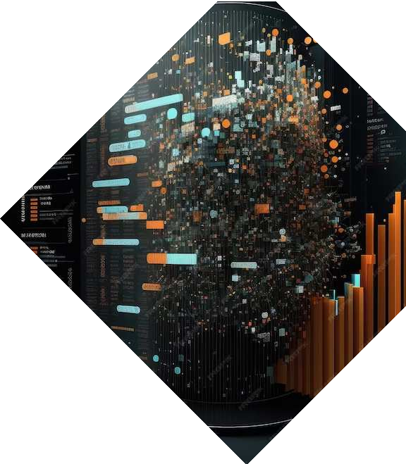
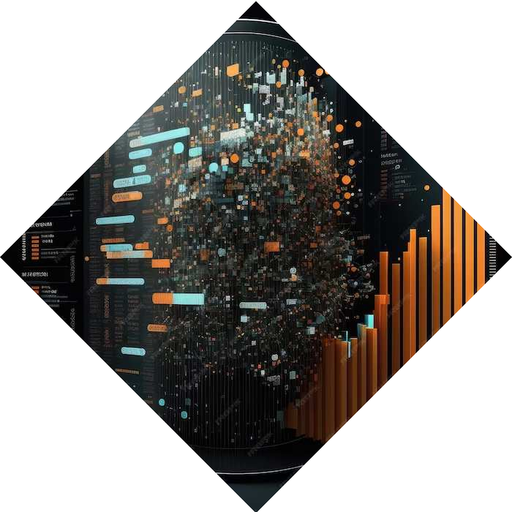
Badji Mokhtar – Annaba UNIVERSITY
Faculty of letters and languages
Annaba, ALGERIA
Information and Communication Technologies (ICT)
Presented by : Assia BOUKHAMLA
2024/2025

Slide 2
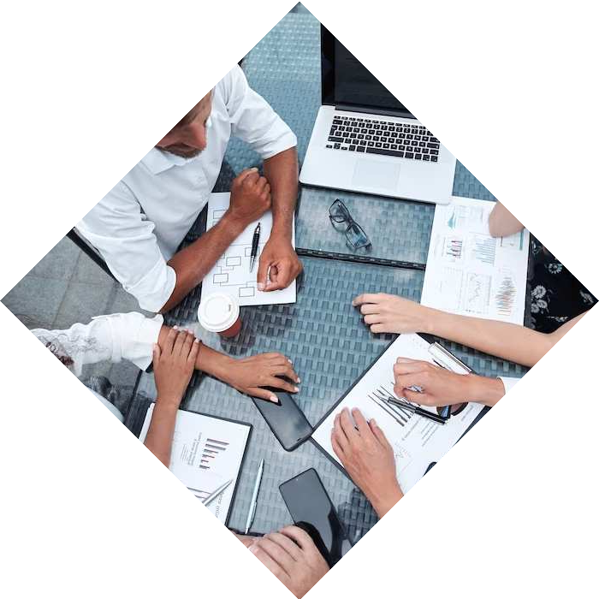
Introduction
In today's fast-paced world, Information and Communication Technology plays a pivotal role in empowering organizations. This presentation explores the potential of ICT in driving innovation, enhancing collaboration, and optimizing operations.

Slide 3
Definition of ICT
refers to the use of technology to manage and process information. It combines both information technology (IT) and telecommunications to enable the sharing, storing, and processing of data and communication.
Computers
Software
networks
internet
Electronic devices

Slide 4
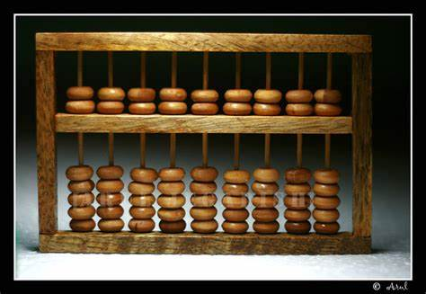
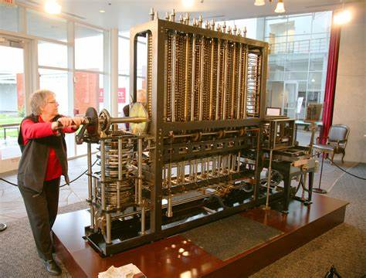
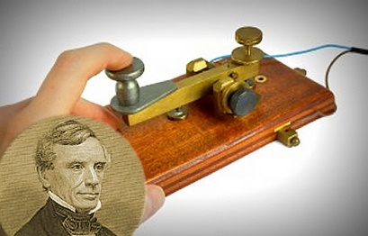
Historical overview
Pre-20th Century: The abacus, one of the earliest computing devices, was developed in Mesopotamia around 2700-2300 BC.
19th Century: Key inventions such as Charles Babbage's Analytical Engine (considered the first mechanical computer) and Samuel Morse's telegraph system laid the groundwork for future technological advancements.

Slide 5
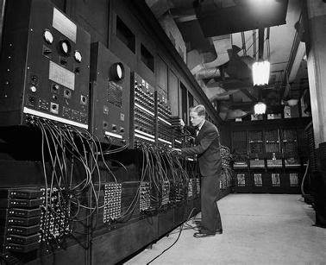
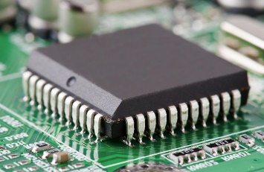
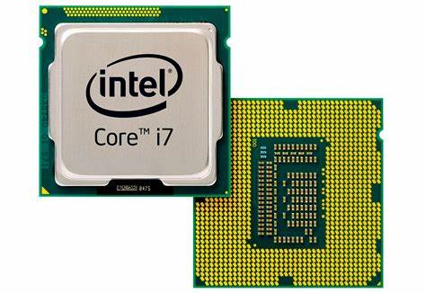
Historical overview
20th Century: Early computers, like the ENIAC, were massive and used primarily for scientific and military applications.
1960s-1970s: The development of integrated circuits (ICs) and microprocessors led to the miniaturization of computers, making them more accessible to a broader audience.

Slide 6
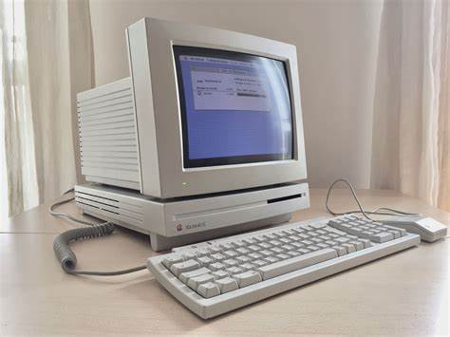
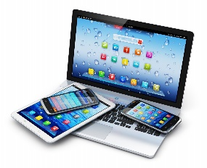
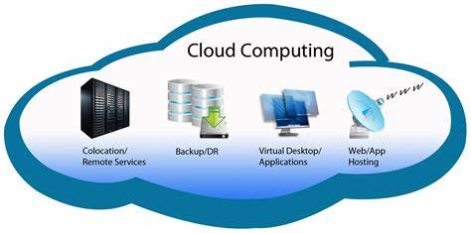
Historical overview
1980s-1990s: The personal computer (PC) revolutionized how individuals and organizations managed data. Additionally, the emergence of the internet, as well as the World Wide Web in the early 1990s, revolutionized global communication.
21st Century: a wide array of technologies, including mobile devices, cloud computing, social media, and the Internet of Things (IoT).

Slide 7
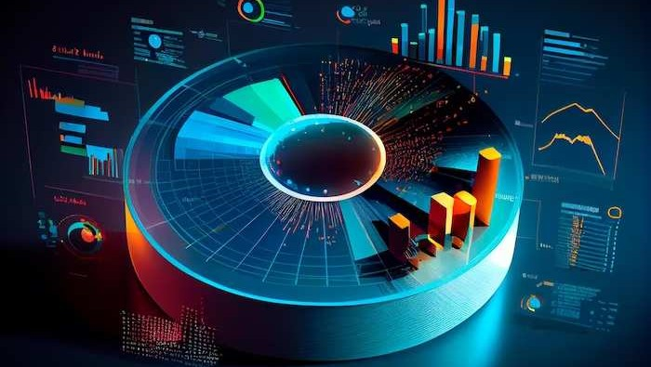
Importance of ICT
ICT plays a pivotal role in modern society and has immense significance for various reasons:
Communication
Information Access
Economic growth
Education
Healthcare
Business and industry
Government and Governance
Sustainability
Social impact

Slide 8
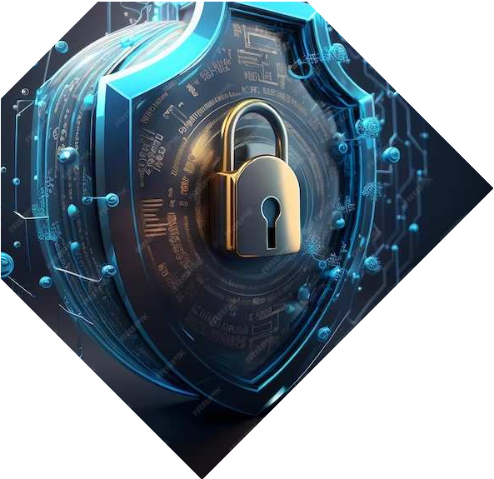
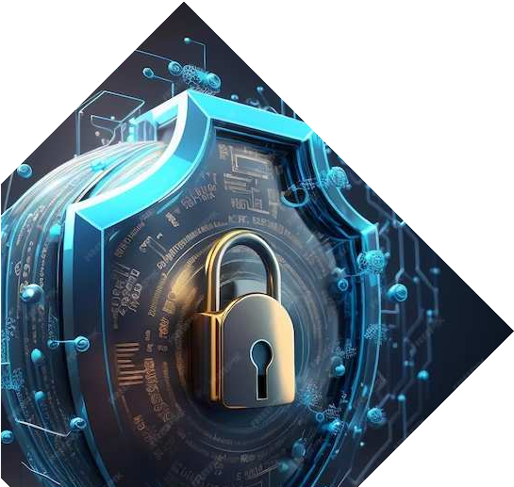
Computer Systems
Computer systems are composed of two main parts: the hardware components and the software, the hardware components include storage devices and computer components, on the other hand, software mean the operating system of the computer, ie. Windows.

Slide 9
Hardware components
Hardware components are the tangible, physical parts of a computer system. These components are crucial for the system to function properly. They include input and output devices, processing units, and storage devices.

Slide 10
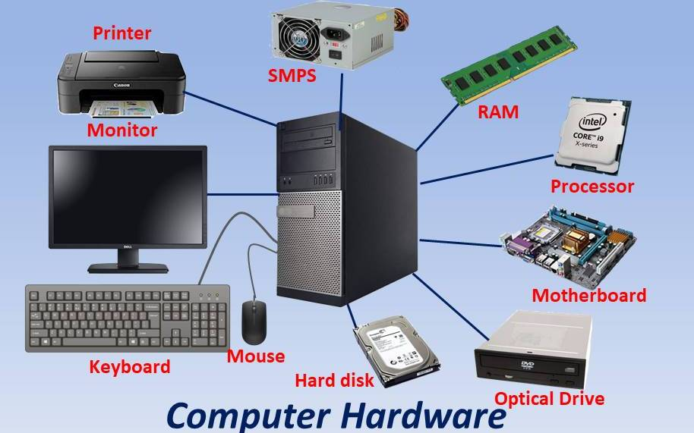
Hardware components

Slide 11
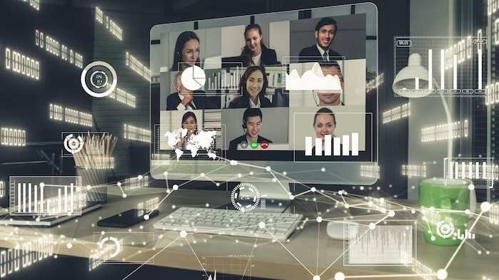
Operating systems (OS)
An operating system (OS) is software that acts as an intermediary between hardware and users. It manages resources, provides a user interface, and ensures the smooth execution of programs.

Slide 12
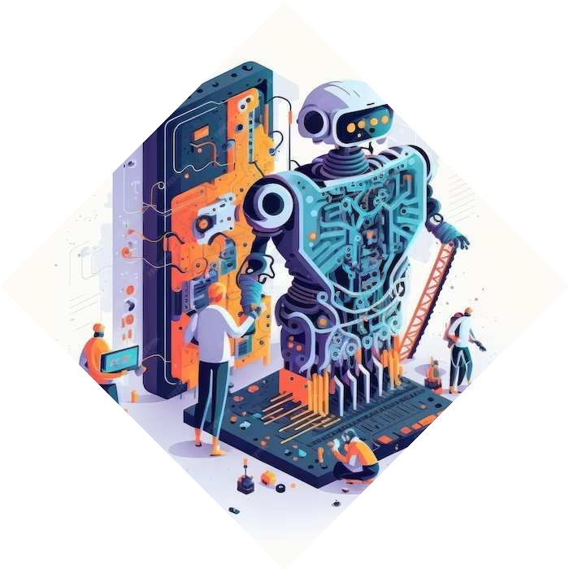
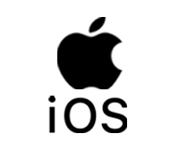
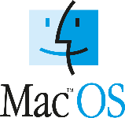
Types of Operating Systems
Windows
Linux
MacOS
Android
iOS

Slide 13
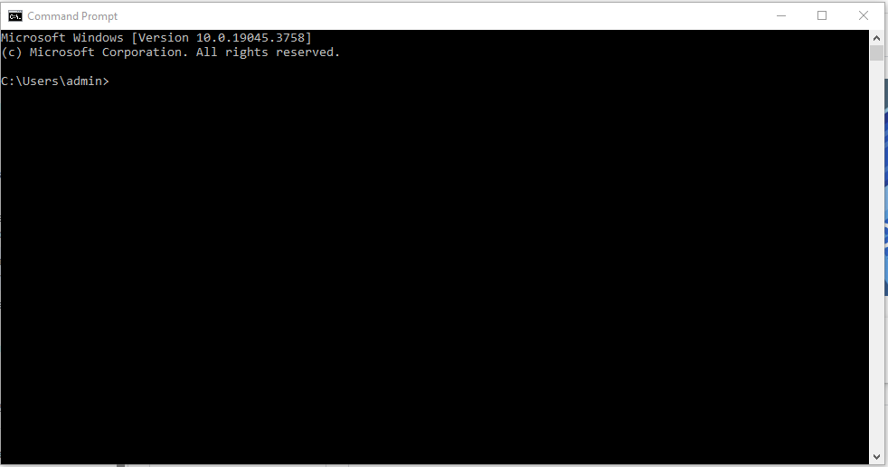
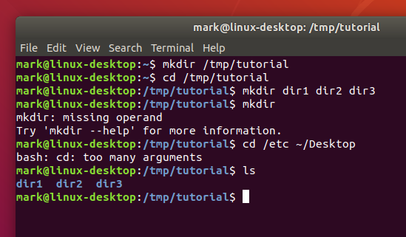
User Interfaces
graphical user interfaces (GUI)
command-line interfaces (CLI)

Slide 14
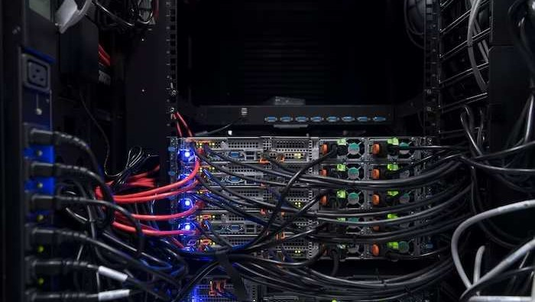
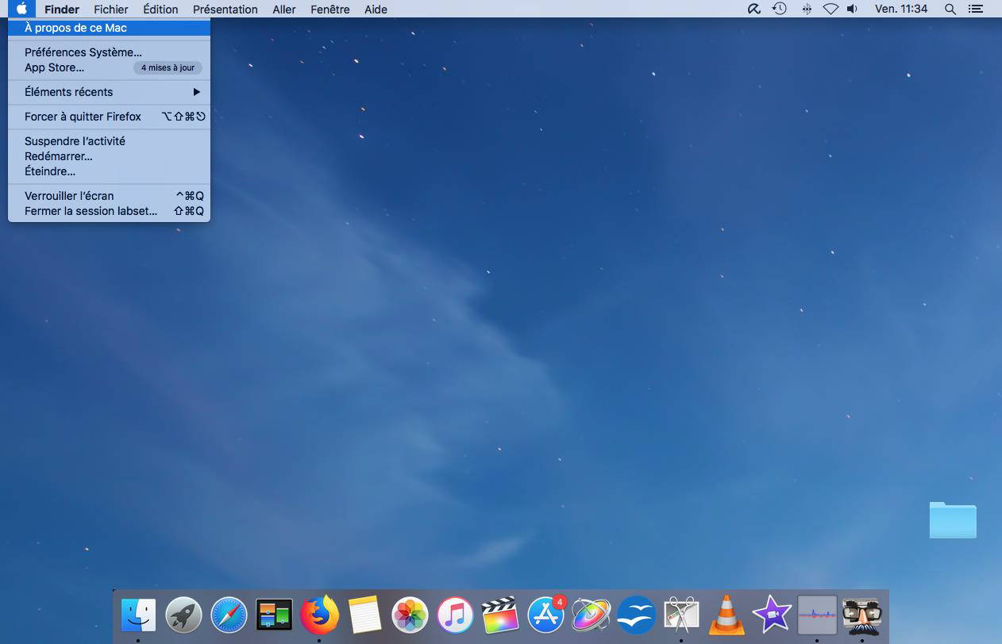
Mac Os

Slide 15
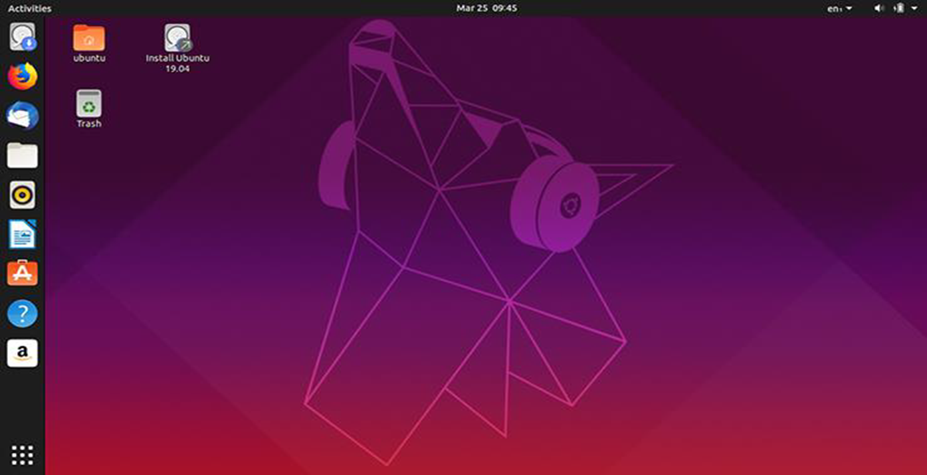
Linux

Slide 16
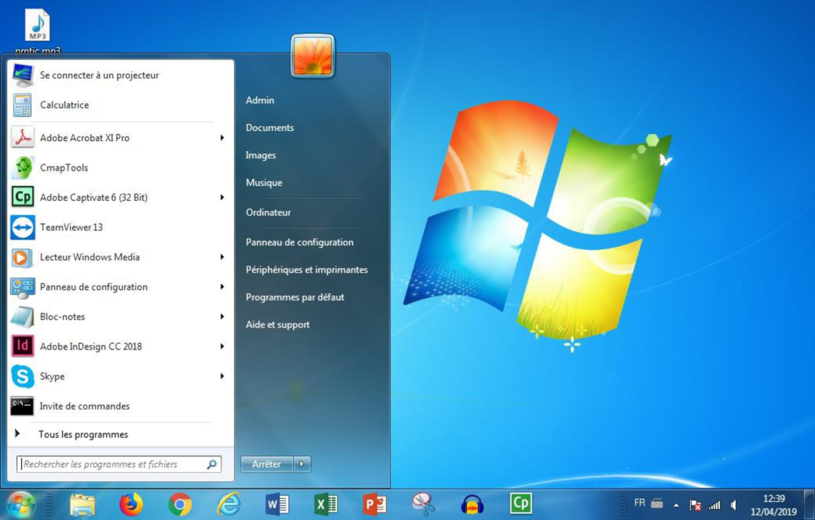
Windows 7

Slide 17
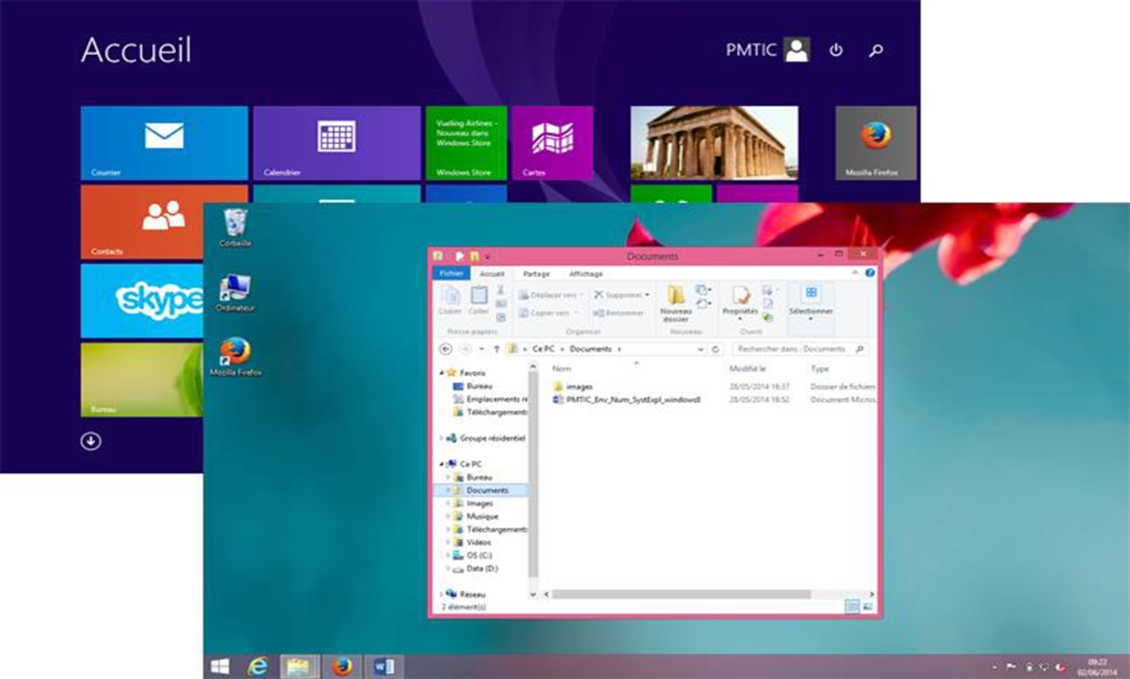
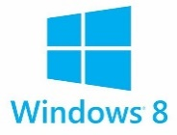
Windows 8

Slide 18
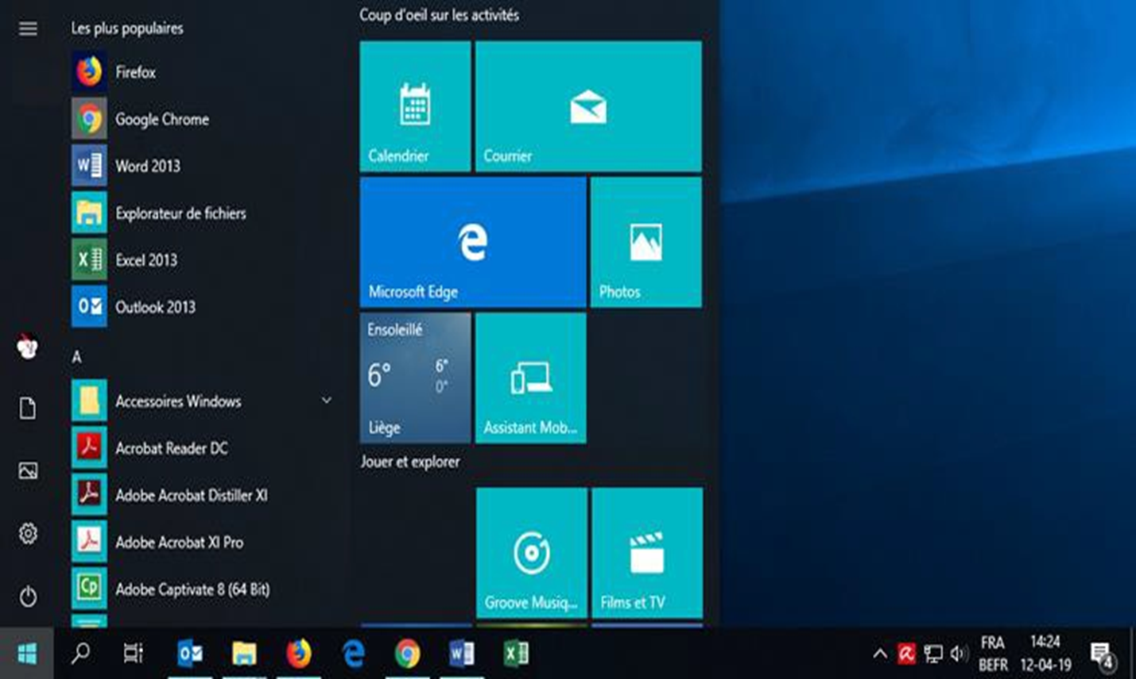
Windows 10

Slide 19
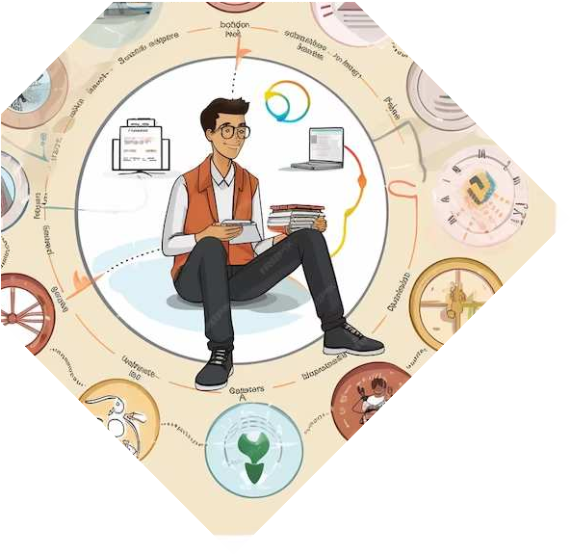
Software Applications
Software applications, or simply software, are programs designed to perform specific tasks on a computer. These applications enhance the functionality and utility of the system.

Slide 20
Types of software applications
a. System Software:
System software, comprising the operating system and utility programs, ensures the smooth functioning of the computer system.
b. Application Software:
Application software includes a diverse range of programs such as word processors, spreadsheets, design tools, and browsers, catering to various user needs.

Slide 21
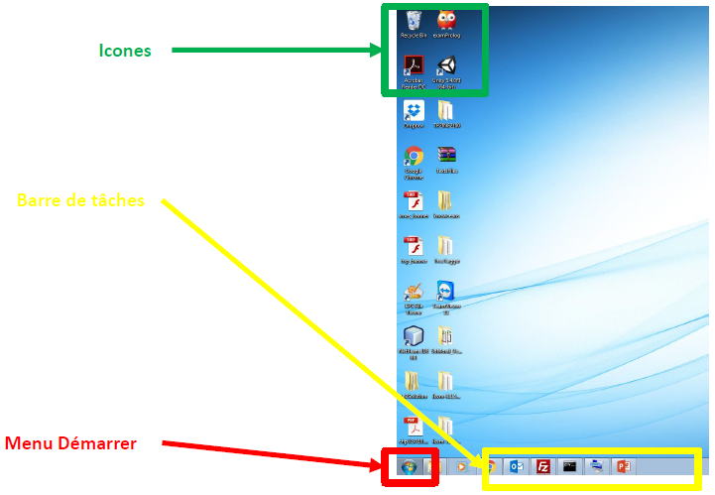
Application software

Slide 22
Some abreviations for Windows
Ctrl + c: Copy
Ctrl + x : Cut
Ctrl + v: Paste
Ctrl + a: Select All
Ctrl + z: Undo
Ctrl + y: Redo
Ctrl + p: Print
Ctrl + s: Save

Slide 23
Computer Networks
A computer network is a set of interconnected devices that can communicate with each other. Networks can be local, connecting devices within a limited area, or wide, connecting devices across larger geographical distances.

Slide 24
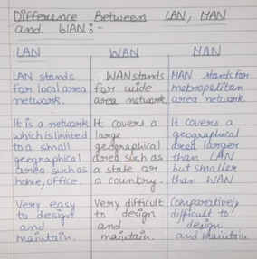
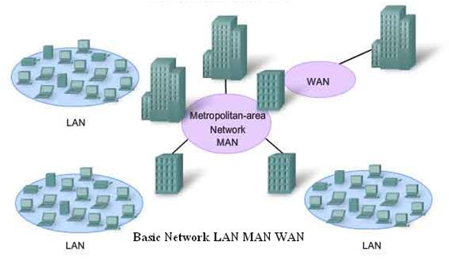
Types of Networks

Slide 25
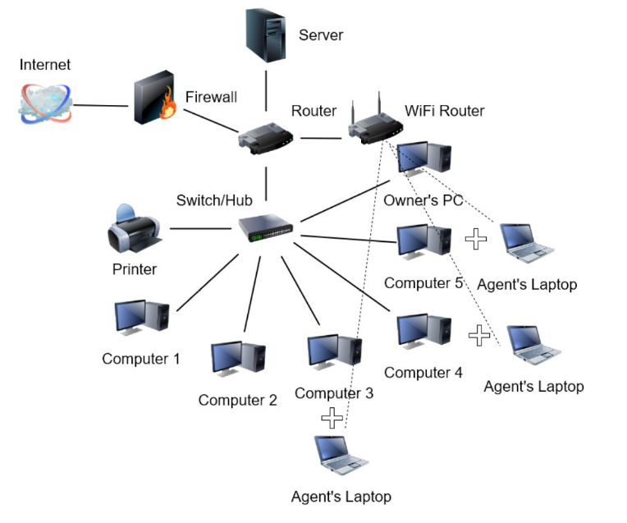
Network components
Nodes

Slide 26
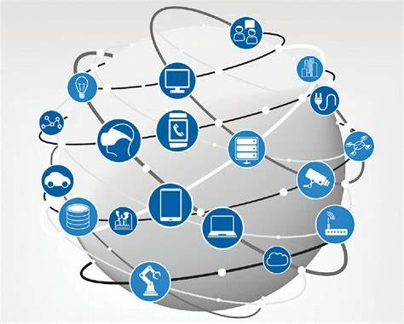
Internet Technologies
The internet originated from ARPANET in the 1960s and has since evolved into a global network connecting billions of devices.

Slide 27
Timeline of the internet

Slide 28
The world wide web (WWW)
The World Wide Web (WWW), commonly known as the web, is a system of interlinked hypertext documents and multimedia content that is accessed via the internet using web browsers. It is a vast information space where documents and resources are identified by Uniform Resource Locators (URLs) and can be linked to each other. The web allows users to navigate between different pages, view text, images, videos, and other multimedia content, and interact with web applications and services. The development of the World Wide Web by Sir Tim Berners-Lee in 1989 revolutionized the way information is accessed and shared on the internet.

Slide 29
Difference between Internet and WWW
The Internet:
The internet is a global network of interconnected computer networks. It is a vast infrastructure that enables the exchange of data and information among devices worldwide. The internet facilitates various services, including email, file sharing, instant messaging, and remote access to resources.
The World Wide Web (The Web):
The World Wide Web is a specific system of interlinked hypertext documents and multimedia content that is accessed over the internet. It is a subset of the internet and represents a way of organizing and accessing information. The web uses URLs (Uniform Resource Locators) to identify and locate resources, and it allows users to navigate between different web pages through hyperlinks.

Slide 30
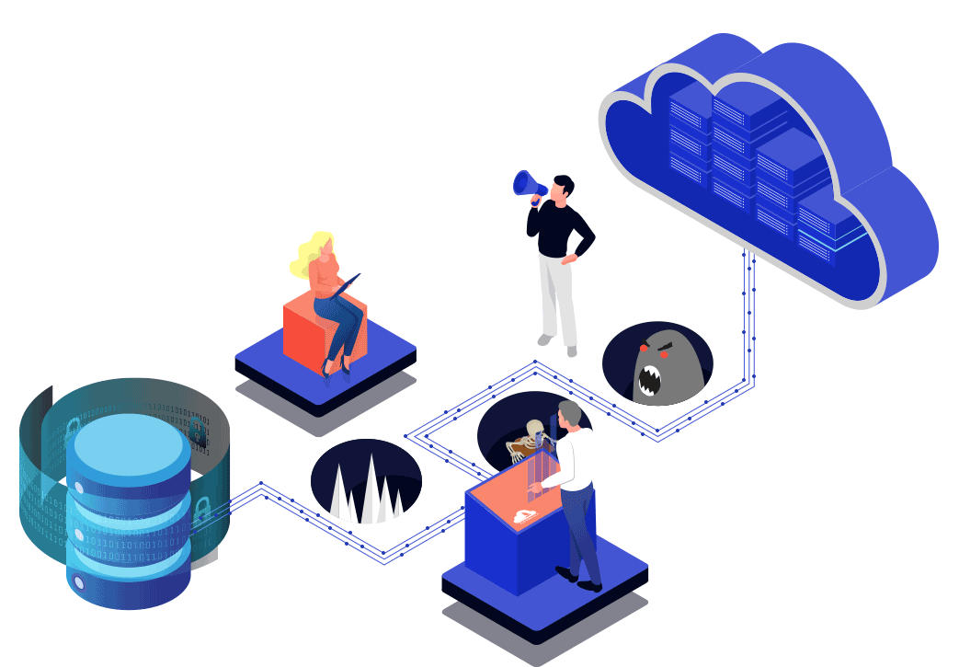
Network security

Slide 31
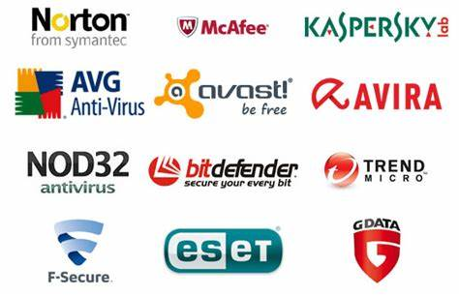
Network Security
Network security is of paramount importance in safeguarding digital systems and data from unauthorized access, data breaches, and malicious activities. As organizations increasingly rely on interconnected networks for communication and data storage, the significance of robust network security measures becomes critical. Common threats and vulnerabilities include malware, phishing attacks, unauthorized access, and weaknesses in software or hardware.

Slide 32
Data management
A database is a structured collection of data that is organized and stored for efficient retrieval and manipulation. It serves as a central repository for information, allowing users to store, manage, and retrieve data.

Slide 33
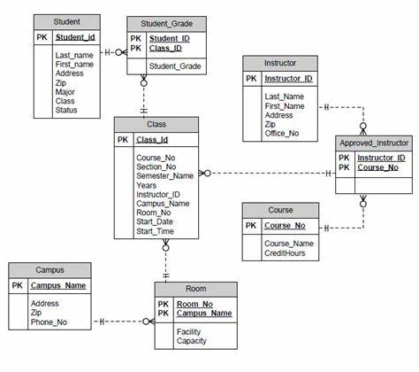
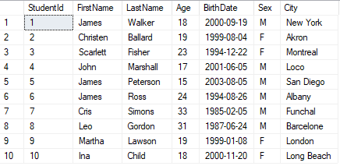
Database

Slide 34
Data manipulation
Data manipulation is like arranging and changing information to make it useful. It means doing things like sorting, filtering, and organizing data so we can understand it better and use it for different purposes.
SQL(Structured Query Language):
SELECT: Choose specific information from a table.
INSERT: Add new data to a table.
UPDATE: Modify or change existing data in a table.
DELETE: Remove data from a table.
CREATE: Make a new table or database object.
DROP: Delete a table, database, or object.
JOIN: Combine information from two or more tables based on a common factor.

Slide 35
SQL query commands

Slide 36
Thanks!
Do you have any questions?
assiaboukhamla@gmail.com

