Slide 1
ORGANS OF SPEECH
Description of the vocal organs
First year Phonetics LMD
Ms. Soumia Aouaidjia

Slide 2
speech mechanism (Articulatory phonetics / Physiological phonetics)
movements beginning at the diaphragm involving different parts of the chest, throat, mouth, and nasal passage.
Speech sounds generated by the force of expiration / processes of breathing
(expiration is silent but the air passing under pressure if controlled or stopped, produces noises).

Slide 3
Articulatory System
Lungs
Vocal folds in Larynx
Articulators

Slide 4
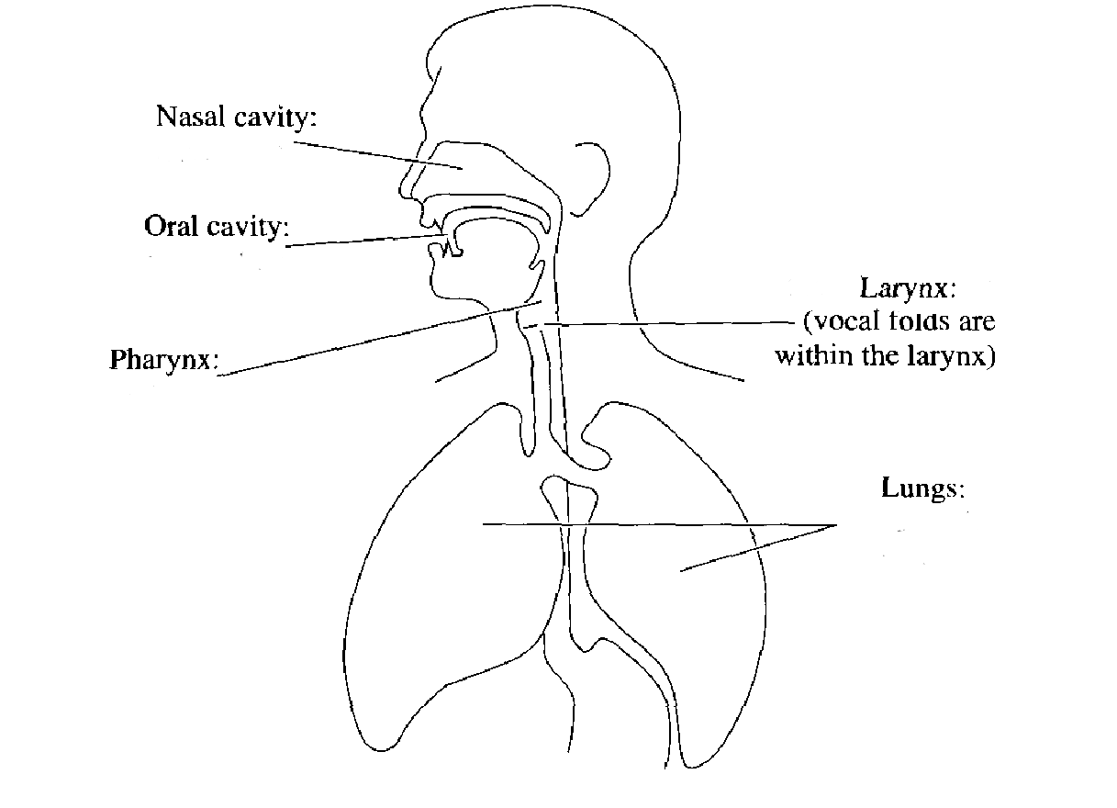

Slide 6
VOCAL TRACT
Larynx
Pharynx
Nasal cavity
Oral cavity
Tongue
Lips
Palate (the roof of the mouth)
Teeth
Mandible (lower jaw)

Slide 7
Vocal Tract

Slide 8
the organs of speech
The Lungs: outgoing breath from the lungs produce sounds of language (Egressive). the air stream emerges from the lungs As a result of the muscle movements, passes through the trachea, larynx, pharynx, nose, or mouth.
Source of Energy: The air stream expelled from the lungs is necessary for any vocal activity and for the production of most English sounds.

Slide 9
Larynx (the voice box)
Two cartilages attached to the top of the trachea.
involved in breathing, sound production, and protecting the trachea against food aspiration (Epiglottis).
The front of larynx has Adam’s Apple, which is a box containing vocal folds.

Slide 10
VOCAL FOLDS

Slide 11
Glottis
combination of the vocal folds and the space in between.
- the vocal folds: two thick flaps of muscles :
can be pulled together completely, resulting in blockage of airstream as in ‘holding a breath’
can become less active and be folded back at each side, resulting in free airflow.
A short blocking by the vocal cords followed by the freeing of air produces sounds.

Slide 12
- The glottis may take three basic positions:
Open glottis vocal folds are spread apart, the air from the lungs passes between them unimpeded (no vibration). Voiceless sounds ( /s,f/)
Vibrating/narrow glottis: vocal folds are drawn together i.e, narrowed, the air pressure from the lungs repeatedly pushes them apart as it passes through, so it is rapidly opened and closed creating vibration effect. Voiced sounds (/z, v/ )
Closed glottis: vocal folds are tightly closed, there is obstruction of air passage: Glottal stop or plosive (/a?a?/).

Slide 14
PHARYNX

Slide 15
ARTICULATORS
The Nasal cavity: It is a fixed body and of fixed dimensions and shape. Its contribution to speech is entirely that of resonance.
The Oral cavity:
control can be caused at the levels: upper lips, upper teeth, alveolar ridge, hard palate, soft palate, velum or uvula. This is partly due to the mobility of the lower jaw. The main places used are the root, back, front, centre, the blade and tip of the tongue.

Slide 18
ORAL CAVITY

Slide 19
HARD PALATE

Slide 20
SOFT PALATE/ VELUM

Slide 21
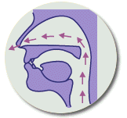
ORAL and NASAL SOUNDS

Slide 22
ALVEOLAR RIDGE /teeth ridge

Slide 23
TEETH

Slide 24
LIPS

Slide 25
Velum /Soft Palate
the membranous part of the roof of the mouth. It can take three different positions:
a- Raised position: velum is lifted by muscles. nasal cavity is blocked. the air stream can only escape through the mouth: velic closure oral Sounds.
b- Relaxed position: velum hang down. the air stream enters the nasal cavity (nose) and the oral one (mouth): velic opening, as in normal breathing.
c- Lowered position: the velum may be lowered. the air stream may enter the nasal cavity. complete obstruction in the oral cavity (mouth closed) . nasal sounds ( /m, n, ŋ/)

Slide 26
The Tongue:
flexible / moveable organ
responsible for varieties of articulation of vowels and consonants
The position helps modifying the quality of a sound.
the tongue is divided into: the front of the tongue, the back of the tongue, the blade and the tip of the tongue. Their movements modify the space through which the air has to pass to produce different sounds.

Slide 27
TONGUE

Slide 28
BACK of the TONGUE

Slide 29
BLADE of the TONGUE

Slide 30
TIP of the TONGUE

Slide 31
Lips
moveable organs that participate in the production of different sounds.
different positions: closed together as in /m/,
relaxed or neutral with the lower jaw as in /e/
held apart remaining close and spread as in /i:/.
held wide open as in /a:/, in round position as in /u:/
open round as in /o/.

Slide 32
LOWER JAW /mandible

Slide 33
NASAL CAVITY

Slide 34
Criteria for the Description of Speech Sounds
Place and manner of sound articulation depend on different positions of articulators:
The air stream: Pulmonic /Non pulmonic, Egressie /Ingressive.
The position of the glottis (voiced/voiceless).
the position of the velum/ soft palate (Oral/ Nasal).
the position of the lips (moveable part).
The position of the tongue (most flexible part).

Slide 35
Organs of Speech
Respiratory System
Phonatory System
Articulatory System
Lungs
Muscles of the chest
Trachea
Pharynx
Lips
Teeth
Roof of the mouth
Tongue
Larynx
Vocal folds
Alveo ridge
Hard palate
Soft palate
Uvula
Tip
Blade
Front
Back
Rims
35

