Slide 1
The Roman Invasion
Module: Civilization and the Target Language
The Instructor: Ms. Charchar Karima

Slide 2
The Reasons of the Roman Invasion
The Romans decided to invade Britain for the following reasons:
1- The Celts of Britain were working with the Celts of Gaul (France) against them.
2- The British Celts were giving them food, and allowing them to hide in Britain.
3- The Celts more advanced in farming and this means that richer, heavier land could be farmed. Moreover, under the Celts Britain had become an important food producer because of its mild climate.
Remmeber: Th Roman first attaempt to invade Britain took place in pre-historic Britain, in 55 BC.
The objective: Romans wanted to invade the whole parts of Britain including, England, Wales, and Scotland.

Slide 3
The Roman Invasion under Julius Caesar
Julius Caesar came to Britain in 55 BC, but it was not until almost a century later, in AD 43 by Emperor Claudius, that a Roman army actually occupied Britain.
They had little difficulty because they had a better trained army and because the Celtic tribes fought among themselves only.
In AD 43 England and Wales became part of the Roman province of Britannia.
The Romans were determined (decided) to conquer the whole island.
The Romans established a Romano-British culture across the southern half of Britain.

Slide 4
Why didn’t Rome take Caledonia (Scotland)?
The Romans could not conquer « Caledonia, » as they called Scotland, although they spent over a century to do so.
At last, they build a strong wall along the northern border, named after the Emperor Hadrian who planned it.
At that time, Hadrian’s Wall was simply intended to keep out the raiders from the north.

Slide 5
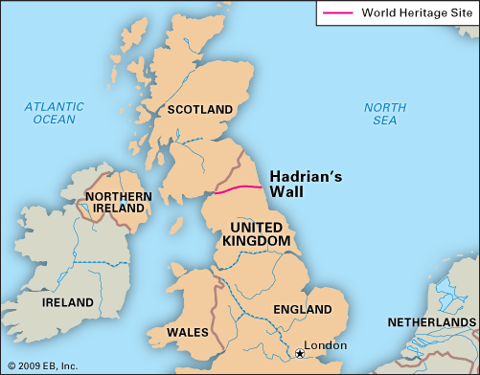
Britain under the Roman Invasion

Slide 6
The End of the Roman Empire in Britain
The Roman control of Britain came to an end as the empire began to collapse.
The first signs were the attacks by the Celts of Caledonia in AD 367.
The Roman legions found it difficult to stop the raiders from crossing Hadrian’s Wall.
The same was happening on the European mainland as Germanic groups called Saxons and Franks, began to raid the coast of Gaul.
In 409 Rome pulled its last soldiers out of Britain and the Romano-British (the Romanized Celts) were left to fight alone against the Scots, the Irish and Saxon raiders from Germany.

Slide 7
The End of the Roman Empire in Britain
The following year, Rome itself fell to raiders.
When Britian called to Rome for help against the raiders from Saxon Germany in the mid-5th century, no answer came.

Slide 8
The Anglo-Saxon Invasion
First Assignment in Civ
Who are the Anglo-Saxons?
Why did they invade Britain?
What impact did they have on Britain?

